Slide 1
LO:
To be able to solve linear equations involving bracket and variables on both sides.
PBS Focus:
Plan:
PBS
Daily review solving equations brackets and variables both sides
Complete all questions on worksheet

Slide 2

Solve: (exercise books)
$3x−7=9−5x$
$5−3x=4x+12$
Equation solving steps:
Simplify both sides
Collect variable terms to left and numbers to right – swap sides swap signs.
Simplify both sides
Divide both sides by coefficient.
Notes:
Run through one at a time. Remember to review whiteboard etiquette.

Slide 3

Solve: white boards
$3(2x−4)=6$
$7(4−3x)=11$
Equation solving steps:
Simplify both sides
Collect variable terms to left and numbers to right – swap sides swap signs.
Simplify both sides
Divide both sides by coefficient.
Notes:
Run through one at a time. Remember to review whiteboard etiquette.

Slide 4
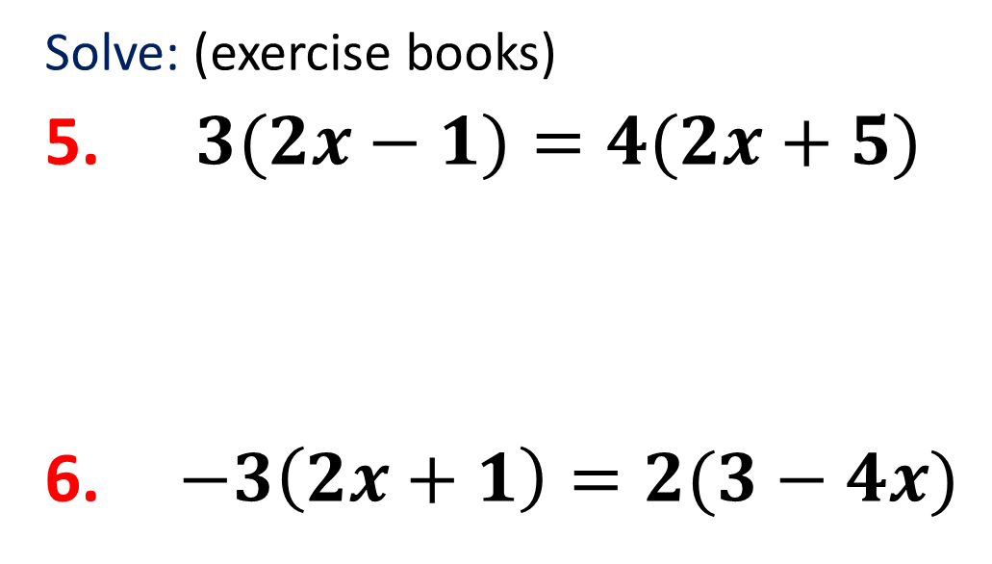
Solve: (exercise books)
$3(2x−1)=4(2x+5)$
$−3\left(2x+1\right)=2(3−4x)$
Equation solving steps:
Simplify both sides
Collect variable terms to left and numbers to right – swap sides swap signs.
Simplify both sides
Divide both sides by coefficient.
Notes:
Run through one at a time. Remember to review whiteboard etiquette.

Slide 5
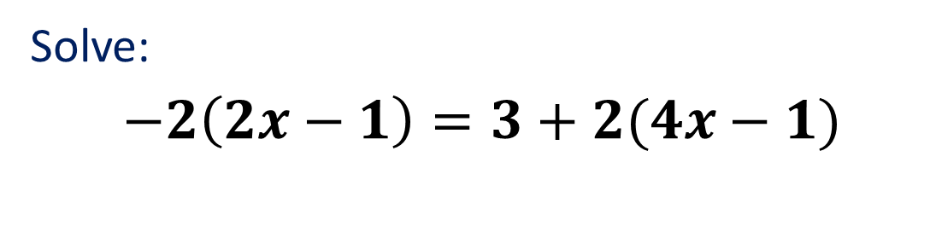
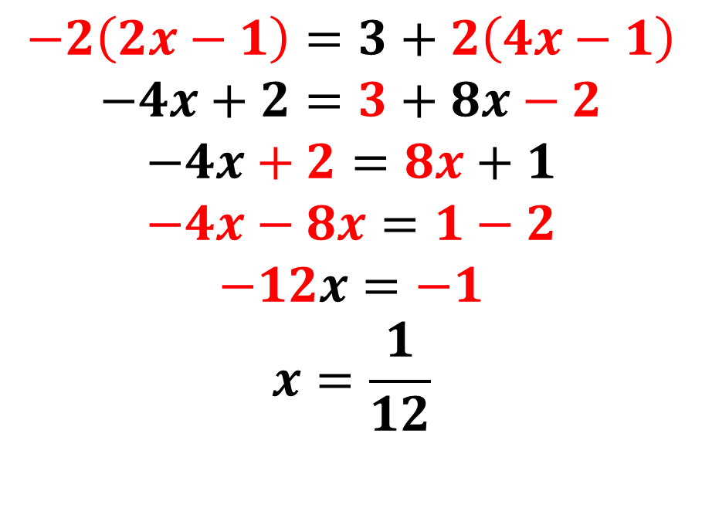
Year 8 A grade – brackets both sides
Solve:
$−2\left(2x−1\right)=3+2(4x−1)$
Equation solving steps:
Simplify both sides
Collect variable terms to left and numbers to right – swap sides swap signs.
Simplify both sides
Divide both sides by coefficient.
$$−2\left(2x−1\right)=3+2\left(4x−1\right)$$
$$−4x+2=3+8x−2$$
$$−4x+2=8x+1$$
$$−4x−8x=1−2$$
$$−12x=−1$$
$$x=\frac{1}{12}$$
Notes:
Run through one at a time. Remember to review whiteboard etiquette.

Slide 6
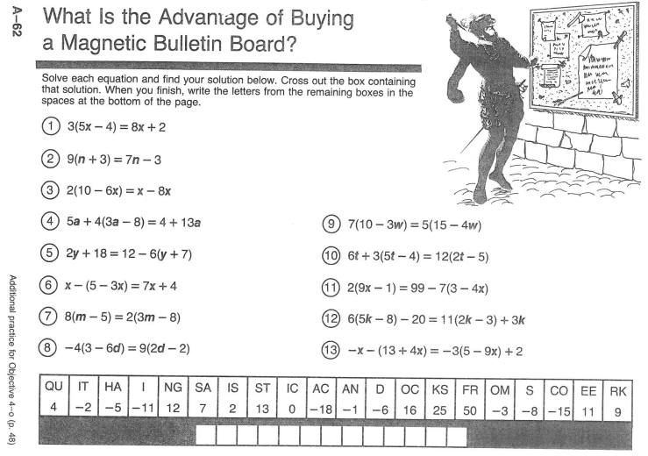
Independent practice
Notes:
Run through one at a time. Remember to review whiteboard etiquette.

